Slide 1

OB 354 Behavior in Organizations
Prof. Fischer

Slide 2

Agenda
Chapter 12 – Teams: Processes and Communication
Chapters 13 & 14 Leadership
2

Slide 3
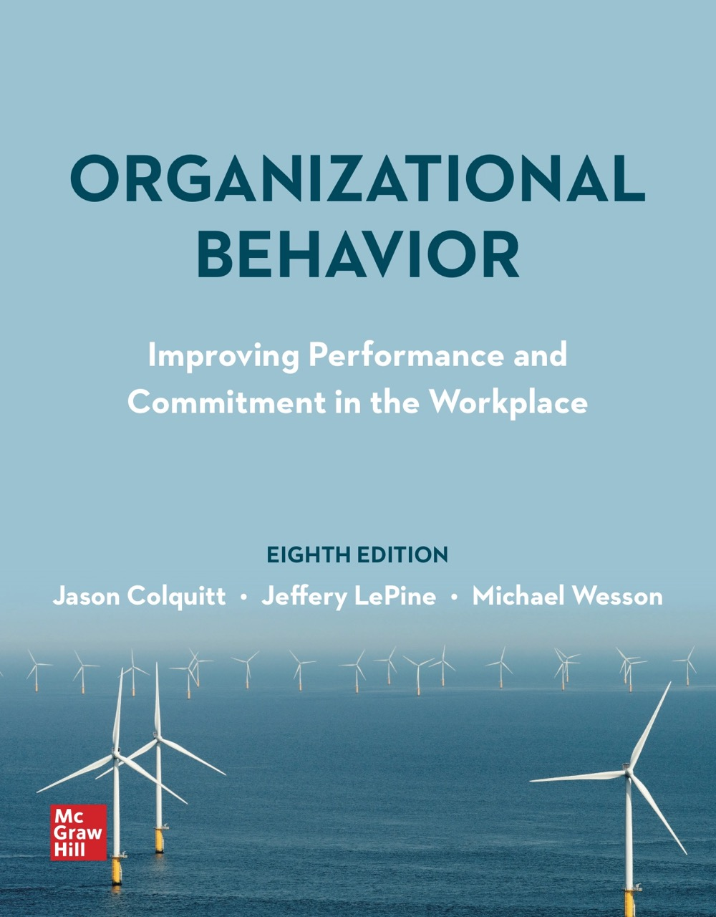
Chapter 13
Leadership: Power and Negotiation
© McGraw Hill LLC. All rights reserved. No reproduction or distribution without the prior written consent of McGraw Hill LLC.

Slide 4
Agenda – Chapter 13
Leadership: Power and Negotiation
Why Are Some Leaders More Powerful than Others?
Acquiring power.
Using influence.
Power and influence in action.
Negotiations.
How Important Are Power and Influence?

Slide 5
Learning Goals
13.1 What is leadership, and what role does power play in leadership?
13.2 What are the different types of power that leaders possess, and when can they use those types most effectively?
13.3 What behaviors do leaders exhibit when trying to influence others, and which of these is most effective?
13.4 What is organizational politics, and when is political behavior most likely to occur?
13.5 How do leaders use their power and influence to resolve conflicts in the workplace?
13.6 What are the ways in which leaders negotiate in the workplace?
13.7 How do power and influence affect job performance and organizational commitment?

Slide 6
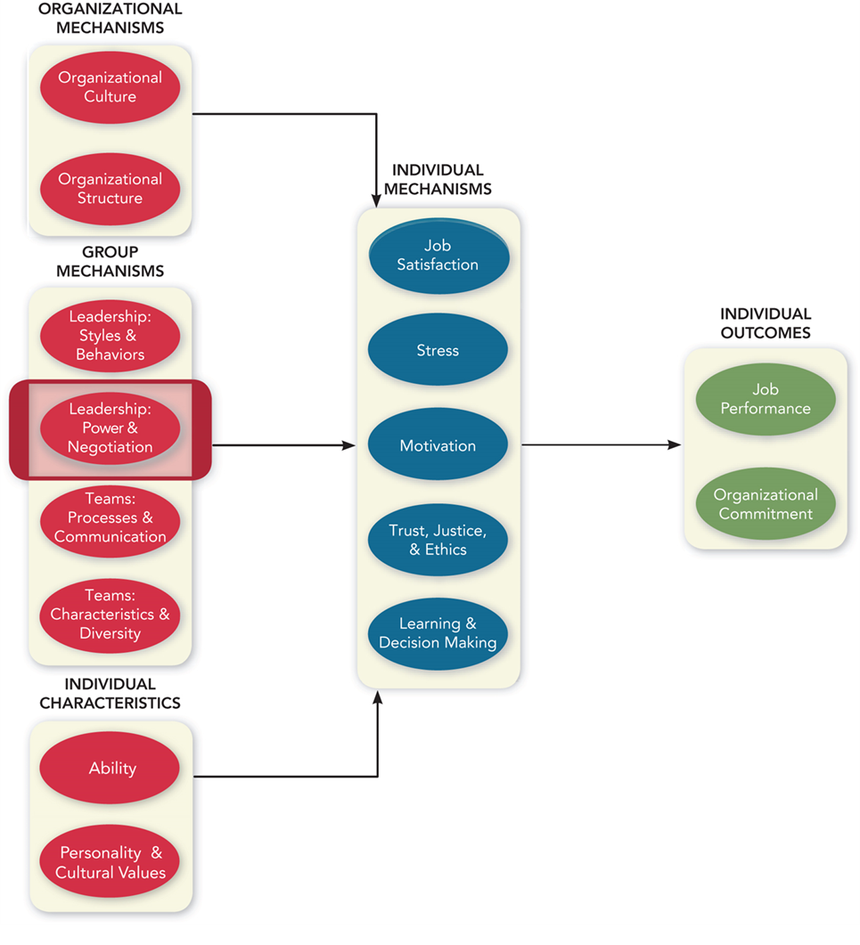
An Integrative Model of Organizational Behavior
Access the text alternative for slide images
Notes:
Here’s the integrative model that reminds students of where they are, where they’ve been, and where they’re going. This is the first of two lectures that acknowledge that the leaders for whom employees work help shape their job satisfaction, stress, motivation, and so forth.

Slide 7
Leadership: Power and Negotiation
Leadership is the use of power and influence to direct the activities of followers toward goal achievement.
When you think of “effective leaders,” who do you think of?
The chapter focus is on how leaders get their power and influence and how they use it in organizations.

Slide 8
Why Are Some Leaders More Powerful Than Others?
Power is the ability to influence the behavior of others and resist unwanted influence in return.
Just because a person has the ability to influence others does not mean they will choose to do so.
Power can be seen as the ability to resist the influence attempts of others.
Voicing a dissenting opinion.
Refusing to perform a specific behaviour.
Organizing an opposition group of coworkers.

Slide 9
Acquiring Power
Organizational power derives from a person’s position within an organization.
Legitimate power is based on a position of authority in an organization.
Reward power is based on control of resources or benefits.
Coercive power is based on ability to punish.
Personal power derives from the individual.
Expert power is based on expertise, skill, or knowledge.
Referent power exists when others have a desire to identify and be associated with a person.

Slide 10
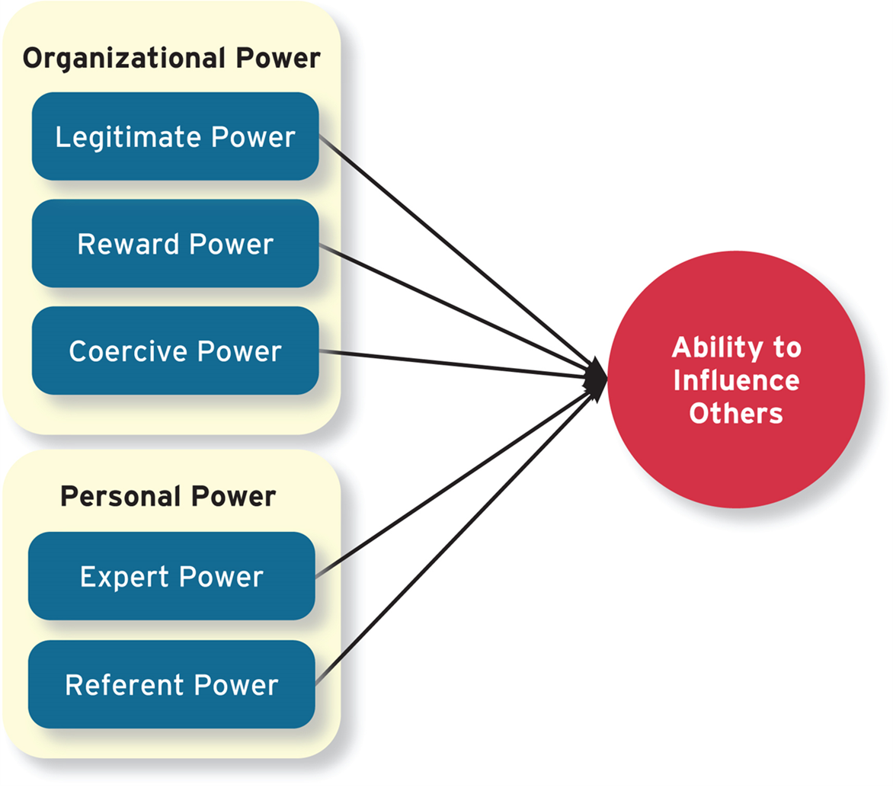
Figure 13-1 Types of Power
Access the text alternative for slide images
Notes:
Personal Power—comes from the person themselves

Slide 11
Table 13-1 Fortune’s 15 Most Powerful Women in Business in 2020
Rank | Name | Company | Position | Age
1 | Julie Sweet | Accenture | C E O | 53
2 | Mary Barra | General Motors | Chair and C E O | 58
3 | Abigail Johnson | Fidelity Investments | Chair and C E O | 58
4 | Gail Boudreaux | Anthem | President and C E O | 60
5 | Caro Tome’ | U P S | C E O | 63
6 | Jane Fraser | Citi | C E O of Global Consumer Banking; president | 53
7 | Ruth Porat | Google, Alphabet | S V P and C F O | 62
8 | Sheryl Sandberg | Facebook | COO | 51
9 | Corie Barry | Best Buy | C E O | 45
10 | Judith McKenna | Walmart Int'l | President and C E O | 54
11 | Safra Katz | Oracle | C E O | 58
12 | Alicia Boler Davis | Amazon | S V P of Global Customer Fulfillment | 50
13 | Karen Lynch | C V S | E V P of CVS Health, president of Aetna | 57
14 | Phebe Novakovic | General Dynamics | Chair and C E O | 62
15 | Ann-Marie Campbell | Home Depot | E V P of U.S. Stores and International Operations | 55
Source: D. Abril, K. Bellstrom, R. Hackett, M. Heimer, E. Hinchliffe, A. Jenkins, B. Kowitt, M. Lev-Ram, S. Mukherjee, A. Pressman, L. Shen, A. Sraders, J. Vanian, P. Wahba, and J. Wieczner, “Most Powerful Women,” Fortune 182, no. 3 (November 2020), pp. 65–77.

Slide 12
Figure 13-1 Types of Power
Access the text alternative for slide images

Slide 13
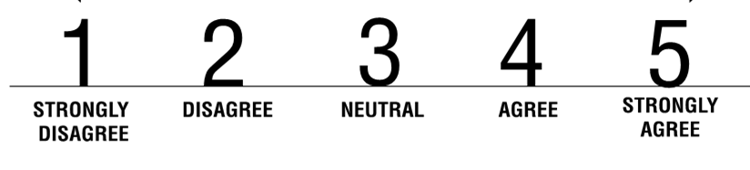
Expert Power
I can provide others with the technical details that they need in their work.
I can give others advice that flows from my unique expertise.
I have skills and training that I can share with others to improve their work.
I am able to provide sound technical suggestions to my colleagues
Average Score: 14

Slide 14
Referent Power
I can make others feel a sense of pride.
I can give others a sense of importance.
I can make others feel a sense of value.
I can serve as a positive role model to others.
Average Score: 12

Slide 15
Table 13-2 Guidelines for Using Power
Type of Power | Guidelines for Use
Legitimate | Stay within the rights your position holds. Communicate your request politely. Make sure you describe the purpose of your request.
Reward | Propose rewards that are attractive. Only offer what you can follow through on. Be clear on exactly what you are offering a reward for.
Coercive | Warn people prior to giving punishment. Make sure punishment is fair relative to the nature of the lack of compliance. Follow through quickly and without discrimination or bias.
Expert | Put forth data or other evidence to support your proposal. Communicate why the request is important and the justification for it. Be consistent, thoughtful, and honest about requests.
Referent | Follow through on commitments. Do things for others even when not required to do so. Support and uphold others when called for.
Source: For a more detailed list of guidelines and discussion, see Gary A. Yukl, Leadership in Organizations, 7th ed. (New York: Pearson, 2010).

Slide 16
Contingency Factors
Substitutability: Having alternatives in accessing resources
Discretion: Having the right to make decisions on their own
Centrality: How important a person’s job is and how many people depend on that person to accomplish their tasks
Visibility: How aware others are of a leader and the resources that leader can provide
Leaders are better able to use their power when they have:
Low substitutability.
High discretion.
High centrality.
High visibility.
Why?

Slide 17
Table 13-3 The Contingencies of Power
Contingency | Leader’s Ability to Influence Others Increases When . . .
Substitutability | There are no substitutes for the rewards or resources the leader controls.
Centrality | The leader’s role is important and interdependent with others in the organization.
Discretion | The leader has the freedom to make their own decisions without being restrained by organizational rules.
Visibility | Others know about the leader and the resources they can provide.

Slide 18
Using Influence
Influence: The use of an actual behavior that causes behavioral or attitudinal changes in others
Most frequently occurs downward (managers influencing employees).
Can also be lateral (peers influencing peers) or upward (employees influencing managers).
Relativity: the degree of disparity between the influencer and the influence.

Slide 19

Most Effective Influence Tactics
Leaders depend on a number of tactics to cause behavioral or attitudinal changes in others:
Rational persuasion: Using logical arguments and facts.
Inspirational appeal: Appealing to values and ideals to create an emotional reaction.
Consultation: Allowing target to participate in decision.
Collaboration: Working together to maximize outcomes.

Slide 20
Moderately Effective Influence Tactics
Tactics that are sometimes effective:
Ingratiation: Using favors, compliments, or friendly behaviour.
Personal appeal: Appealing to personal friendship or loyalty.
Apprising: Explaining how the target will personally benefit.

Slide 21
Least Effective Influence Tactics
Least effective tactics:
Pressure: Using coercive power through threats or demands.
Coalitions: Enlisting others to help influence the target.
Exchange tactic: Offering a reward or resource in return for performing a request.

Slide 22
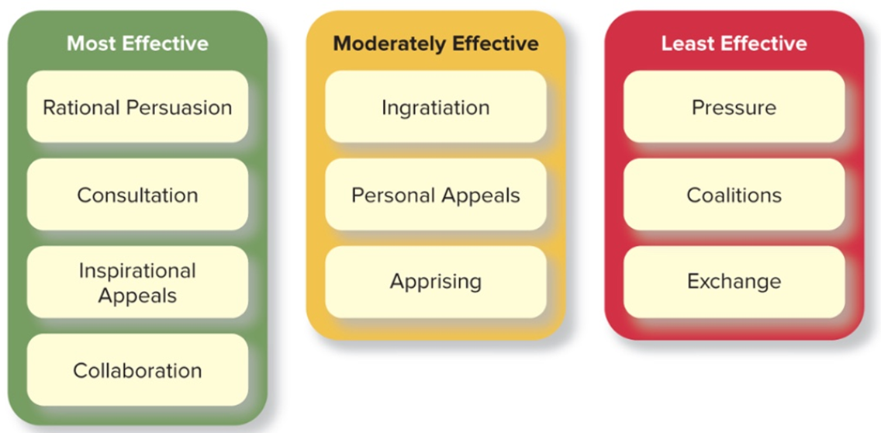
Figure 13-2 Influence Tactics and Their Effectiveness
Source: Adapted from S. Lee, S. Han, M. Cheong, S.L. Kim and S. Yun, "How Do I Get My Way? A Meta-Analytic Review of Research on Influence Tactics," Leadership Quarterly 28 (2017), pp. 210-28.
Access the text alternative for slide images

Slide 23

Responses to Influence Tactics
People have three possible responses to influence tactics:
Internalization: Both behavior and attitude shift to agreement.
Compliance: Behavior shifts to agreement but attitude does not.
Resistance: Neither behavior nor attitude shifts to agreement.

Slide 24
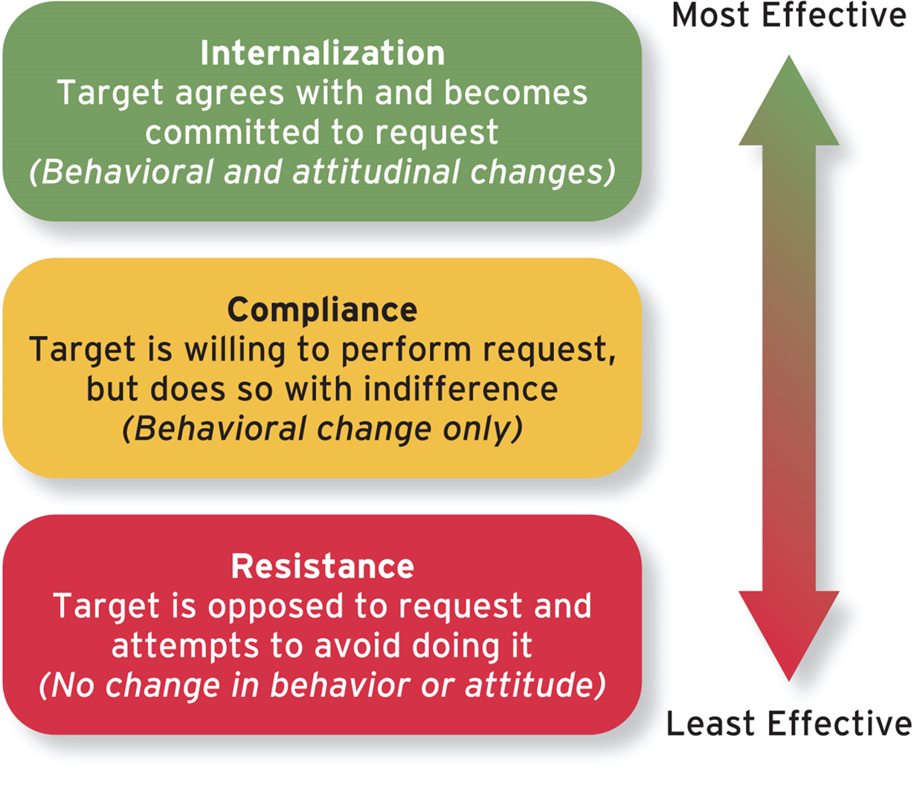
Figure 13-3 Responses to Influence Attempts
Access the text alternative for slide images

Slide 25
Power and Influence in Action
Leaders can use their power and influence in a number of ways, including:
Navigating the political environment in the organization.
Resolving conflicts within the organization.

Slide 26
Organizational Politics
Actions by individuals that are directed toward the goal of furthering their own self-interests
Political skill: Understanding others at work and using that knowledge to influence others in ways that enhance personal and/or organizational objectives
Networking ability is an adeptness at identifying and developing contacts.
Social astuteness is the tendency to observe others and accurately interpret their behavior.
Interpersonal influence involves having a personal style that’s flexible enough to adapt to different situations.
Apparent sincerity involves appearing to others to have high levels of honesty and genuineness.

Slide 27
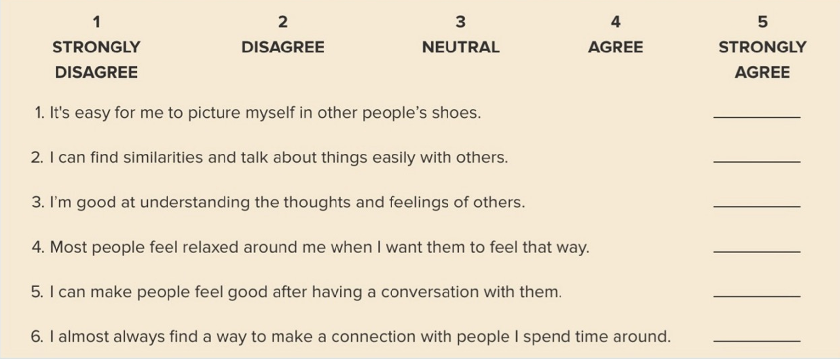
Political Skill Assessment
Source: For a more detailed measure of political skill, see G.R. Ferris, D.C. Treadway, R.W. Kolodinsky, W.A. Hochwarter, C.J. Kacmar, C. Douglas, and D.D. Frink, “Development and Validation of the Political Skill Inventory,” Journal of Management 31 (2005), pp. 126–52.
Average Score: 23
Access the text alternative for slide images

Slide 28
Negative Effects of Organizational Politics
People’s perceptions of politics are generally negative.
Environments that are perceived as extremely political can:
Lower job satisfaction.
Increase strain.
Lower job performance.
Increase turnover intentions.
Lower organizational commitment.

Slide 29
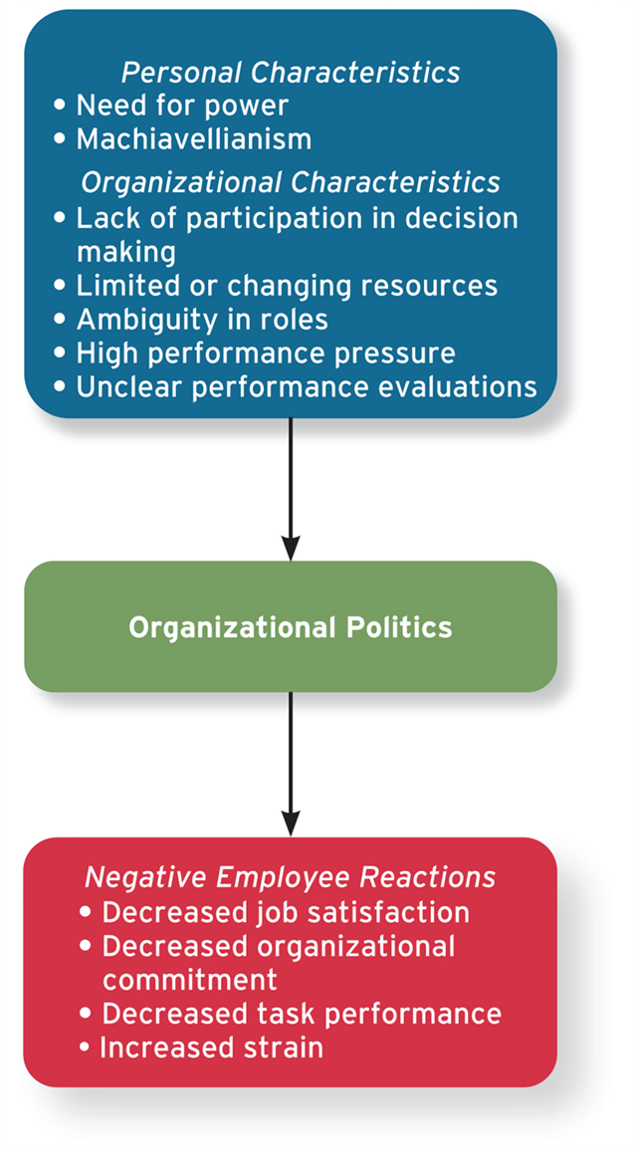
Figure 13-4 The Causes and Consequences of Organizational Politics
Access the text alternative for slide images

Slide 30

Google Case
Learning Goals:
13.2 What are the different types of power that leaders possess, and when can they use those types most effectively?
13.3 What behaviors do leaders exhibit when trying to influence others, and which of these is most effective?
13.4 What is organizational politics, and when is political behavior most likely to occur?

Slide 31
Conflict Resolution
Conflict: when two or more individuals perceive that their goals are in opposition
Conflict resolution is influenced by two factors:
How assertive leaders want to be in pursuing their own goals.
How cooperative they are with regard to the concerns of others.
Five different styles of conflict resolution:
Competing (high assertiveness, low cooperation).
Avoiding (low assertiveness, low cooperation).
Accommodating (low assertiveness, high cooperation.
Collaboration (high assertiveness, high cooperation).
Compromise (moderate assertiveness, moderate cooperation).

Slide 32
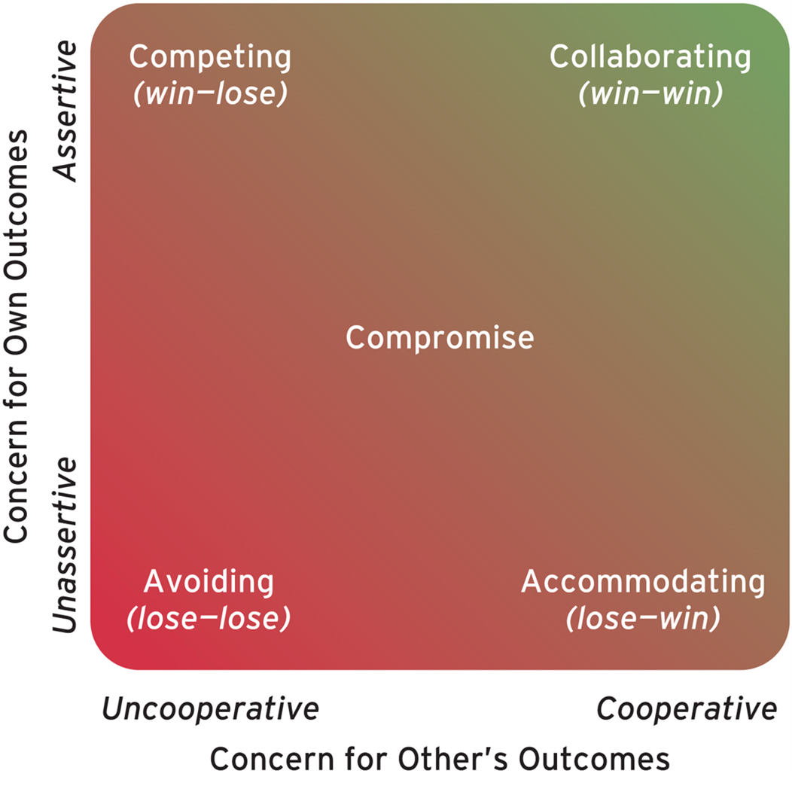
Figure 13-5 Styles of Conflict Resolution
Access the text alternative for slide images

Slide 33
Table 13-4 When to Use the Various Conflict Resolution Styles
Resolution Style | Use During the Following Situations:
Competing | A quick decision is really important. When you believe you are right, other solutions are wrong, and there is no middle ground. When someone will try to leverage your unwillingness to compete against you.
Avoiding | If the issue is not as important as others from a timing perspective. When there is no acceptable alternative and you can’t win. Arriving at a solution will cause more strife than a solution is worth. When people’s emotions are running high and backing off might help come up with a resolution. If acquiring more information would help arrive at a better solution.
Collaborating | When both parties have legitimate concerns and compromise won’t solve the problem. When different perspectives or learning might help arrive at a better alternative. To build commitment by working together toward a consensus decision.
Accommodating | If you arrive at the conclusion that your choice or solution is wrong or that an alternative is better. When you want to show that you are reasonable and/or to build up credit with others. When others care substantially more about the outcome than you do and the ongoing relationship is important. If you are going to lose and want to preserve your dignity.
Compromising | When a strong approach isn’t worth the damage it might cause. If both parties are committed to their choices and they are equally powerful. Arriving at an interim solution allows you to examine a complicated issue more fully. When time pressure doesn’t allow for a protracted resolution. When other approaches haven’t worked.
Source: Adapted from K.W. Thomas, “Toward Multi-Dimensional Values in Teaching: The Example of Conflict Behaviors,” Academy of Management Review (1977), pp. 484–90.

Slide 34

Negotiations
A process in which two or more interdependent individuals discuss and attempt to come to an agreement about their different preferences
Negotiation strategies include:
Distributive bargaining: win-lose style with fixed pie, zero-sum conditions.
Integrative bargaining: win-win style utilizing mutual respect and problem solving.

Slide 35
Negotiation Stages
Regardless of strategy used, negotiation typically goes through a series of stages:
Preparation: Each party determines goals and alternatives.
Exchanging information: Each party makes a case for its position.
Bargaining: Both parties must likely make concessions.
Closing and commitment: The agreement is formalized.
Notes:
best alternative to a negotiated agreement, or BATNA.

Slide 36
Negotiator Biases
Perceived power relationship between the parties is an important factor.
When negotiators perceive themselves as having more power than the other party, they tend to demand more and concede less. (distributive approach).
When negotiators perceive themselves as relatively equal in power, they take a more integrative approach.
Negotiator emotions, both positive and negative, can negatively influence negotiation success.
Positive emotions may lead to agreeing too quickly.
Negative emotions may lower judgment accuracy.

Slide 37
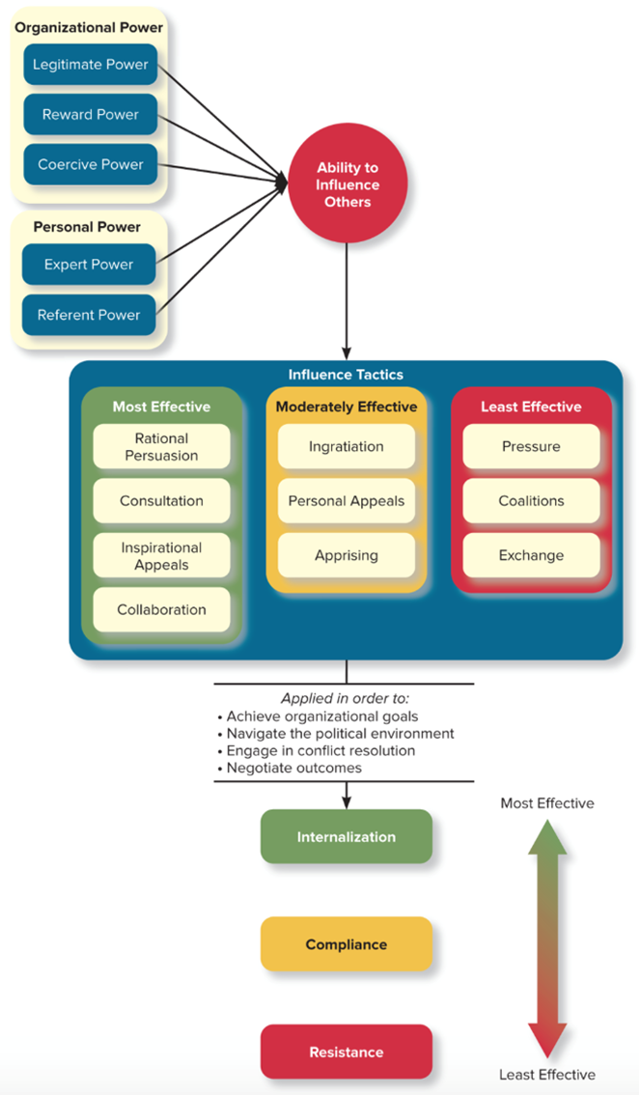
Figure 13-6 Why Are Some Leaders More Powerful Than Others?
Access the text alternative for slide images

Slide 38
How Important Are Power and Influence?
Power and influence are moderately correlated with job performance and organizational commitment.
Effective use of power and influence can
Create internalization.
Increase citizenship behaviour.
Decrease counterproductive behaviour.
Increase the motivation levels of employees.
Increase job satisfaction.

Slide 39
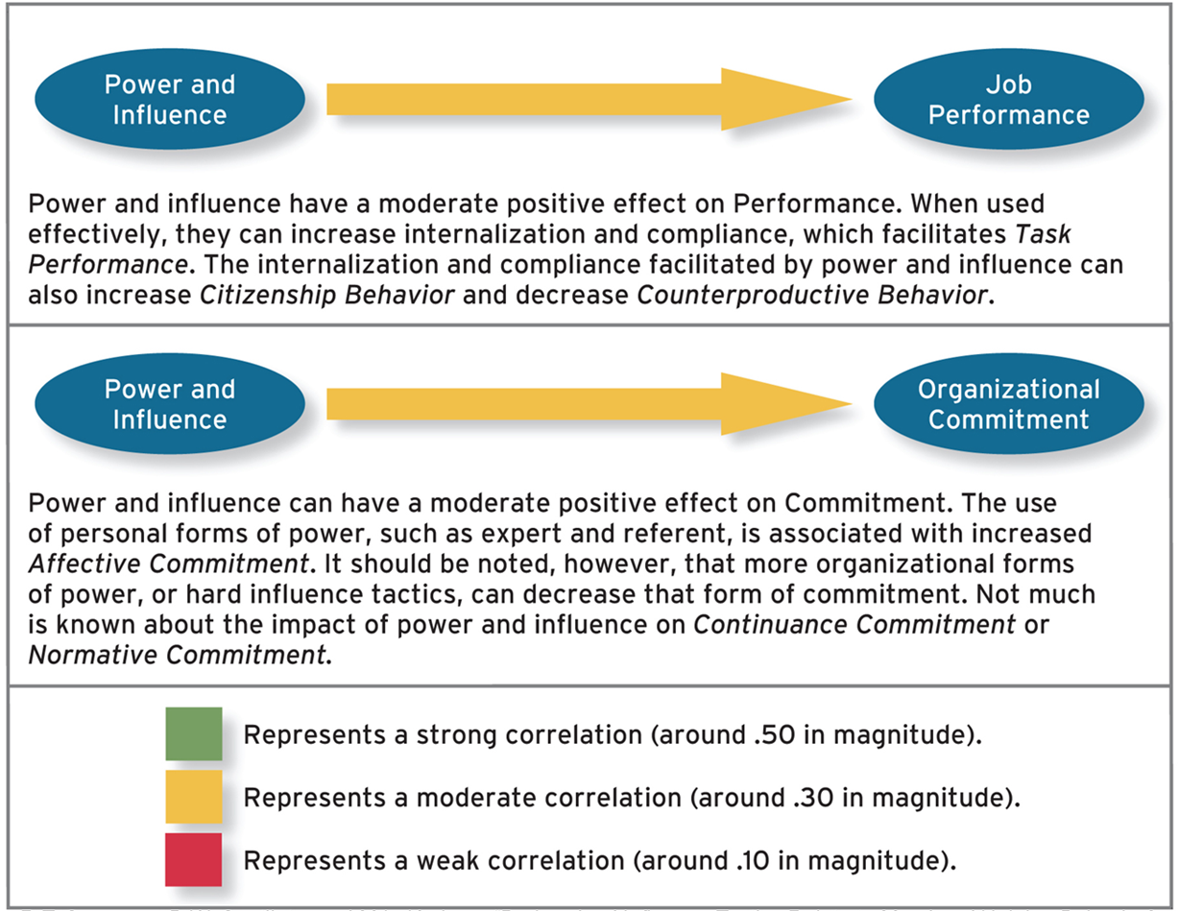
Figure 13-7 Effects of Power and Influence on Performance and Commitment
Source: R.T. Sparrowe, B.W. Soetjipto, and M.L. Kraimer, “Do Leaders’ Influence Tactics Relate to Members’ Helping Behavior? It Depends on the Quality of the Relationship,” Academy of Management Journal 49 (2006), pp. 1194–1208; G. Yukl, H. Kim, and C.M. Falbe, “Antecedents of Influence Outcomes,” Journal of Applied Psychology 81 (1996), pp. 309–17; and P.P. Carson, K.D. Carson, and C.W. Rowe, “Social Power Bases: A Meta-Analytic Examination of Interrelationships and Outcomes,” Journal of Applied Social Psychology 23 (1993), pp. 1150–69.
Access the text alternative for slide images

Slide 40
Next
Chapter 14: Leadership: Styles and Behaviors

